Slide 1
IT Professional Environment: Law, Ethics and Privacy
Week 7:
Lecturer: Dr. Farshid Keivanian

Slide 2
Social Consequences of IT
Introduction: The rapid advancement of information technology has led to significant social changes, affecting various aspects of life, including communication, work, education, and social interactions.

Slide 3
Social Consequences of IT
Practical Scenario: Imagine a scenario where a new social media platform, "ConnectAus," is launched in Australia, promising to revolutionize how people interact online. While the platform gains popularity, it also raises concerns about privacy, data security, and its impact on real-life social interactions.
Class Discussion Question: How can ConnectAus ensure that its platform promotes positive social interactions while addressing concerns related to privacy and data security?

Slide 4
Social Consequences of IT
Responses:
Implementing strict privacy controls and user data protection policies.
Encouraging responsible use of the platform through education and awareness campaigns.
Regularly reviewing and updating privacy policies based on user feedback and legal requirements.

Slide 5
Social Consequences of IT
Multiple-Choice Question: What is a potential social consequence of widespread IT use?
A) Improved face-to-face communication
B) Decreased privacy
C) Reduced online presence
D) Increased physical activity

Slide 6
Technological Change
Introduction: Technological change refers to the ongoing development and adoption of new technologies, which can lead to significant shifts in industries, economies, and everyday life.

Slide 7
Technological Change
Practical Scenario: Consider the introduction of autonomous delivery drones by a logistics company in Sydney. While this innovation promises faster deliveries, it also poses challenges such as job displacement and regulatory issues.
Class Discussion Question: What steps should the logistics company take to manage the impact of autonomous delivery drones on its workforce and ensure regulatory compliance?

Slide 8
Technological Change
Responses:
Offering retraining programs for employees whose jobs may be affected.
Collaborating with regulatory bodies to establish guidelines for drone operations.
Engaging with the community to address concerns and gather feedback.

Slide 9
Technological Change
Multiple-Choice Question: Which of the following is a challenge associated with technological change?
A) Increased manual labor
B) Job displacement
C) Slower delivery times
D) Decreased innovation

Slide 10
Education
Introduction: Technology has transformed education by providing new tools and resources for learning, enabling online education, and promoting personalized learning experiences.

Slide 11
Education
Practical Scenario: Imagine a university in Melbourne implementing a new AI-driven platform, "EduLearn," that offers personalized learning paths for students based on their performance and learning styles.
Class Discussion Question: How can the university ensure that EduLearn effectively enhances the learning experience without disadvantaging students who may struggle with technology?

Slide 12
Education
Responses:
Providing training sessions for students to become familiar with the platform.
Ensuring access to necessary technology and resources for all students.
Continuously monitoring and adjusting the platform based on student feedback.

Slide 13
Education
Multiple-Choice Question: What is one benefit of integrating technology into education?
A) Personalized learning experiences
B) Limited access to learning resources
C) Increased reliance on traditional teaching methods
D) Reduced collaboration among students

Slide 14
Employment
Introduction: The rise of technology has significantly impacted employment, leading to the creation of new job roles while making some traditional roles obsolete.

Slide 15
Employment
Practical Scenario: A tech startup in Brisbane, "JobTech," develops a platform that uses AI to match job seekers with employers. While the platform improves job matching efficiency, it also raises concerns about algorithmic bias.
Class Discussion Question: How can JobTech address concerns about algorithmic bias to ensure fair and equitable job matching?

Slide 16
Employment
Responses:
Implementing transparency in how the AI algorithm makes decisions.
Regularly auditing the algorithm for potential biases and adjusting as necessary.
Engaging with diverse stakeholders to ensure the platform meets the needs of all users.

Slide 17
Employment
Multiple-Choice Question: What is a potential drawback of technology's impact on employment?
A) Creation of new job roles
B) Increased flexibility for workers
C) Job displacement due to automation
D) Enhanced job matching efficiency

Slide 18
Social Networks
Introduction: Social networks have revolutionized the way people connect, share information, and communicate, but they also present challenges such as misinformation, cyberbullying, and privacy concerns.

Slide 19
Social Networks
Practical Scenario: A social network based in Canberra, "NetConnect," is facing criticism for its handling of user data and the spread of misinformation on its platform.
Class Discussion Question: What strategies should NetConnect implement to address these issues and rebuild trust with its users?

Slide 20
Social Networks
Responses:
Enhancing data privacy policies and giving users more control over their information.
Implementing stricter content moderation to prevent the spread of misinformation.
Providing users with clear and accessible information about how their data is used.

Slide 21
Social Networks
Multiple-Choice Question: Which of the following is a challenge associated with social networks?
A) Improved face-to-face interactions
B) Increased privacy for users
C) Spread of misinformation
D) Decreased online engagement

Slide 22
Banking
Introduction: Technology has transformed banking, leading to the rise of online banking, mobile payment systems, and fintech innovations that offer greater convenience and accessibility.

Slide 23
Banking
Practical Scenario: A major bank in Sydney, "AussieBank," launches a new mobile payment app, but faces challenges related to security breaches and user adoption.
Class Discussion Question: How can AussieBank ensure the security of its mobile payment app while encouraging widespread user adoption?

Slide 24
Banking
Responses:
Implementing advanced security measures such as biometric authentication.
Educating users about the app's security features and how to protect their information.
Offering incentives for users to adopt the app, such as cashback or discounts.

Slide 25
Banking
Multiple-Choice Question: What is one advantage of technology in banking?
A) Greater convenience for users
B) Increased need for physical bank branches
C) Reduced security risks
D) Decreased access to financial services

Slide 26
Shopping
Introduction: Technology has revolutionized shopping, enabling online shopping, personalized recommendations, and the use of data analytics to understand consumer behavior.

Slide 27
Shopping
Practical Scenario: An e-commerce platform in Melbourne, "ShopSmart," uses AI to provide personalized product recommendations, but customers express concerns about privacy and data usage.
Class Discussion Question: What steps should ShopSmart take to balance personalization with customer privacy concerns?

Slide 28
Shopping
Responses:
Providing clear and transparent information about data collection and usage.
Allowing customers to customize their privacy settings and control what data is collected.
Ensuring that data is securely stored and not shared with third parties without consent.

Slide 29
Shopping
Multiple-Choice Question: Which of the following is a benefit of technology in shopping?
A) Decreased consumer choice
B) Increased in-store shopping
C) Higher costs for consumers
D) Personalized product recommendations

Slide 30
Legal
Introduction: The legal landscape has evolved with technology, leading to new challenges such as cybercrime, data privacy, and intellectual property issues.

Slide 31
Legal
Practical Scenario: A legal firm in Brisbane, "LawTech," is helping clients navigate the complexities of cybercrime laws and data protection regulations.
Class Discussion Question: How can LawTech ensure that its clients are fully informed and compliant with the latest cybercrime laws and data protection regulations?

Slide 32
Legal
Responses:
Providing regular updates and training sessions on relevant laws and regulations.
Offering comprehensive legal advice tailored to each client's industry and needs.
Collaborating with cybersecurity experts to provide a holistic approach to compliance.

Slide 33
Legal
Multiple-Choice Question: What is a legal challenge associated with technology?
A) Cybercrime and data breaches
B) Increased physical theft
C) Simplified intellectual property management
D) Reduced need for legal services

Slide 34
Philosophy of Technology
Introduction: The philosophy of technology explores the ethical, social, and philosophical implications of technology on society, questioning how technology shapes human life and values.

Slide 35
Philosophy of Technology
Practical Scenario: A think tank in Canberra, "TechPhilosophy," is conducting research on the ethical implications of AI in decision-making processes within organizations.
Class Discussion Question: What ethical considerations should TechPhilosophy focus on when evaluating AI's role in decision-making?

Slide 36
Philosophy of Technology
Responses:
Ensuring transparency and fairness in AI decision-making processes.
Addressing potential biases in AI algorithms and their impact on marginalized groups.
Considering the long-term societal impact of widespread AI adoption.

Slide 37
Philosophy of Technology
Multiple-Choice Question: What does the philosophy of technology primarily focus on?
A) The technical specifications of new technologies
B) The speed of technological innovation
C) The economic benefits of technology
D) The ethical and social implications of technology

Slide 38
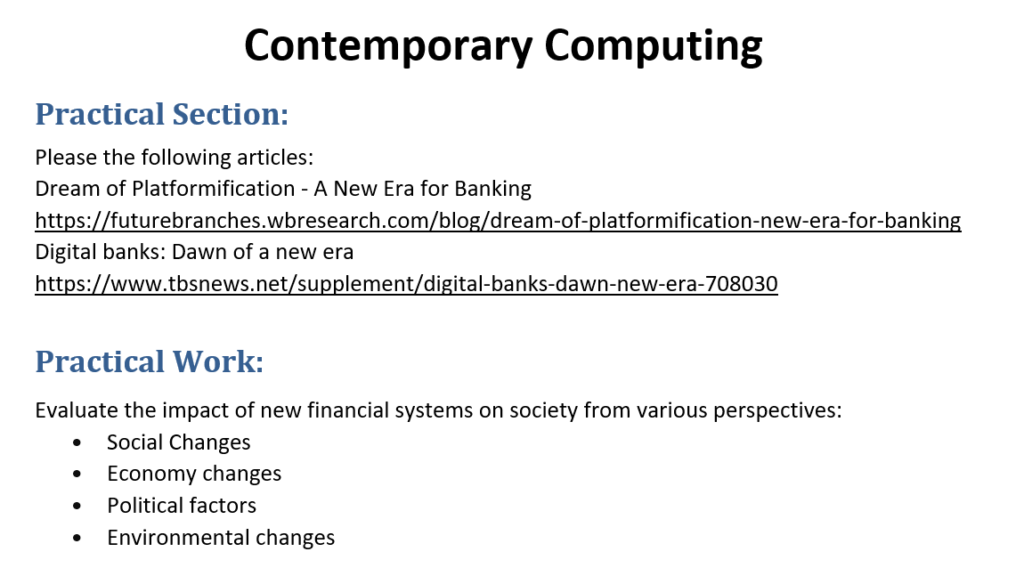
Tutorial Week 7

Slide 39
Evaluation of the Impact of New Financial Systems on Society - Social Changes
The shift towards digital banking and platformification significantly impacts social dynamics. As physical bank branches become less relevant, access to financial services is increasingly determined by digital literacy and access to technology. This change can lead to social exclusion for those who lack access to digital devices or the internet, particularly in rural or underprivileged areas. However, it also promotes financial inclusion by offering services to those previously unbanked or underbanked, as digital banks can reach remote areas without the need for physical branches. The social landscape is thus altered, with a growing divide between those who can engage with these new financial systems and those who cannot.

Slide 40
Economic Changes
Economically, the adoption of platformification and digital banks can lead to reduced operational costs for financial institutions, as they no longer need to maintain as many physical branches. This can result in lower fees for customers and more competitive financial products. The use of AI and machine learning in digital banking allows for better analysis of customer data, leading to more personalized financial services and products. This shift also opens new revenue streams for banks by partnering with fintechs and other digital service providers. However, the reduced need for physical infrastructure and human labor could lead to job losses, particularly in traditional banking roles.

Slide 41
Political Factors
From a political perspective, the rise of digital banks and platformification raises regulatory challenges. Governments need to adapt existing financial regulations to oversee digital banks effectively, ensuring they meet the same standards of security, transparency, and consumer protection as traditional banks. In some countries, the introduction of digital banks is driven by political agendas aiming to modernize financial systems and increase financial inclusion. However, there is also the risk of increased political scrutiny and control over financial transactions, as governments may seek greater oversight of digital financial flows.

Slide 42
Environmental Changes
The environmental impact of moving towards digital and platform-based banking is complex. On one hand, reducing the need for physical bank branches and paper-based transactions can decrease the carbon footprint of financial services. On the other hand, the increased reliance on data centers and digital infrastructure could lead to higher energy consumption. Furthermore, the production and disposal of digital devices, essential for accessing these services, also have environmental consequences. Therefore, while there are potential environmental benefits, they must be weighed against the environmental costs associated with the digital infrastructure required to support these new financial systems.

Slide 43
Summary
The transition to new financial systems, driven by digital banking and platformification, brings about significant changes across social, economic, political, and environmental dimensions. While these changes offer many benefits, such as increased financial inclusion, reduced operational costs, and more personalized services, they also present challenges, including social exclusion, regulatory hurdles, job displacement, and environmental concerns. As these systems continue to evolve, it will be crucial to address these challenges to ensure that the benefits of new financial systems are realized in a way that is equitable and sustainable for society as a whole.

